Slide 1
Investigation of Active/Passive Mode-locking in THz QCL’s
Solving Maxwell Bloch equations
for sample FL178C-M7 from Optics Express paper:
“2.9 THz quantum cascade lasers operating up to 70 K in continuous wave”
S. Barbieri, J. Alton, H. E. Beere, J. Fowler, E. H. Linfield, and D. A. Ritchie

Slide 2
Contents
Quantum well structure
Material parameters
Eigenmodes
Scattering times and dipole elements:
-@ T = 70K
Maxwell-Bloch model equations
References

Slide 3
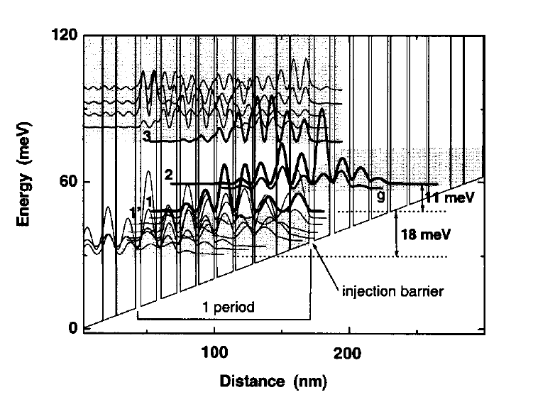
Quantum Well Structure
Based on Ref. [3] Bound to Continuum design.

Slide 4
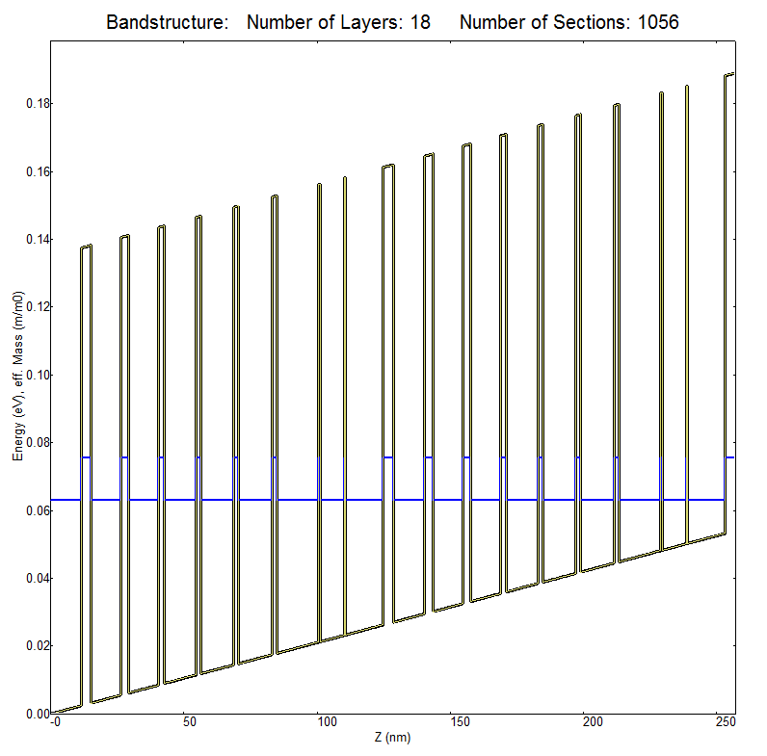
Simulated Structure ( 2 periods on the image) :
1 period’s Barrier/Well thicknesses: 3.8/14.0/ 0.6/ 9.0/ 0.6/15.8/ 1.5/12.8/ 1.8/12.2/ 2.0/12.0/ 2.0/11.4/ 2.7/11.3/ 3.5/ 11.6
Material System: - Barriers: Al0.15Ga0.85As - Wells: GaAs
Operating Bias: 2.2 kV/cm
Period Length: 128.9 nm

Slide 5
Material Parameters:
GaAs Ref. [1]
Property | Value
Effective Electron Mass | 0.063 [m0]
Effective Energy Gap | 1.42 [eV]
Lattice Constant | 0.565325 [nm]
AlxGa1-xAs,
X = 0.15 Ref. [2]
Property | Value
Effective Electron Mass | 0.063 + 0.083x = 0.07545 [m0]
Effective Energy Gap | 1.42 + 1.247x = 1.60705 [eV]
Lattice Constant | 0.565325 + 0.00078x = 0.565442 [nm]
Barrier Height ??? Bandgap Offset??? Approx 135 [meV] Ref. [4]

Slide 6
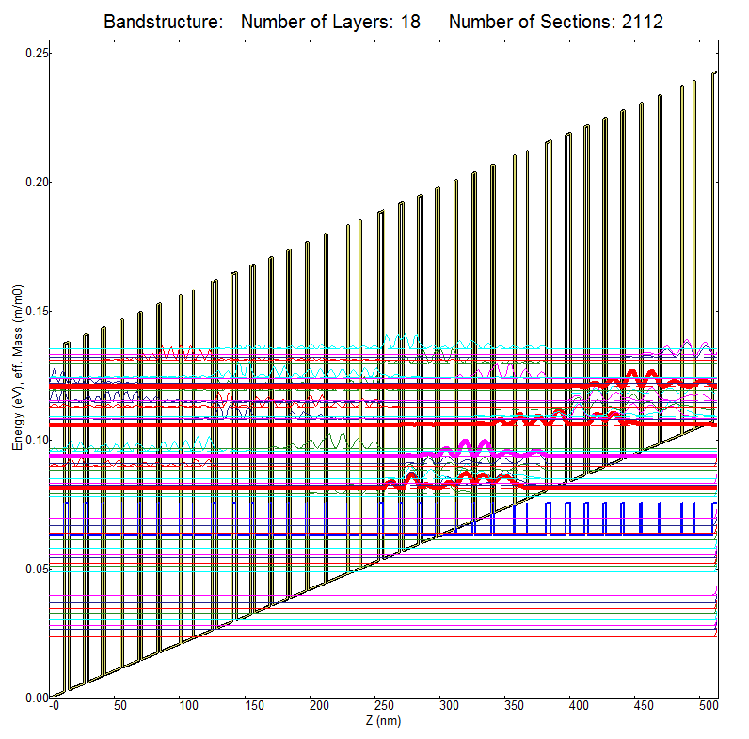
Eigenmodes:
Name | State Nr. | Energy [meV]
INJ | 4 | -120.9
UL | 3 | -106.0
LL | 2 | -93.9
DEPOP | 1 | -81.2
E32 = 12.1[meV] ≈ 2.9 [THz] E43 = 14.9 [meV]
E21 = 12.7 [meV]
|4>
|3>
|2>
|1>

Slide 7
Scattering Times at 70K
LO-scattering Times Matrix Tij at T = 70K
 | 4 | 3 | 2 | 1
4 | 0.52 | 7.59 | >200 | >200
3 |  | 1.37 | 18.63 | 8.4
2 |  |  | 0.75 | 3.03
1 |  |  |  | 9.94
Dim Mtx. Elements Matrix Zij at T = 70K
 | 4 | 3 | 2 | 1
4 | 0 | 0.06 | 0.04 | 0.01
3 | 0.06 | 0 | 4.34 | 0.32
2 | 0.04 | 4.34 | 0 | 0.19
1 | 0.01 | 0.32 | 0.19 | 0

Slide 8
Maxwell-Bloch model equations
In the following we make the next 4 assumptions:
at each point along the growth direction of the QCL, there is a 4 level
system
the injector level is |4>.
|3> and |2> are the lasing states, i.e. the upper and lower laser level,
respectively.
|1> is the current extraction level, or the depopulation level.
Back-scattering events are not considered, i.e. the event that an electron
can, after cascading through some of the 5 levels, can back-scatter to a
higher energy level of the system.

Slide 9
Maxwell-Bloch model equations

Slide 10
References
http://www.ioffe.ru/SVA/NSM/Semicond/GaAs/basic.html
http://www.ioffe.ru/SVA/NSM/Semicond/GaAs/bandstr.html
S. Barbieri, J. Alton, H. E. Beere, J. Fowler, E. H. Linfield, and D. A. Ritchie , “2.9 THz quantum cascade lasers operating up to 70 K in continuous wave”, Appl. Physics Letters

